Slide 1
Natural Language Generation
Creating a Story

Slide 2
Project Goal
The goal of this project is to find and implement the best approach to generate the text of a new story
Further I would like to generate text that is similar to the stories used in training
The generated story needs to be different enough that it is convincing that the model generated the text
I began with neural network architecture using RNN and LSTM and finished with transformers architecture specifically using Open AI’s GPT-2

Slide 3
Introduction
Natural Language Generation (NLG) or Text Generation is a subfield of Natural Language Processing (NLP). Its goal is to generate meaningful phrases and sentences in the form of human-written text.
Use Cases
Natural Language Generation can be used for creating reports, articles, summarizing written documents, product descriptions or postings
I chose to have generate a new story. Others that have taken this approach to do story generation have used it for such things as creating stories for video games, marketing stories, it could be used to generate suggestions or suggest corrections to actual authors and it may allow journalists to do more investigating and less writing

Slide 4
Starting With The Data
Kaggle has many sites with novels for datasets: https://www.kaggle.com/khulasasndh/game-of-thrones-books https://www.kaggle.com/santiviquez/hp1txt
A site which focuses on older out of copyright works that are in pretty nice formats already: https://www.gutenberg.org/
A site that has books to read for free and you can web scrape them if needed: https://novel80.com/

Slide 5
Data Preparation
Add whitespace before and after punctuation characters – to make sure to recognize as separate tokens
Remove double whitespace characters
Tokenize text
Map tokens to indexes

Slide 6
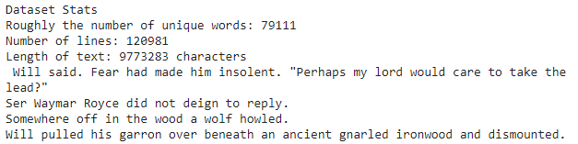
Game of Thrones Novels Preprocessing the Data

Slide 7
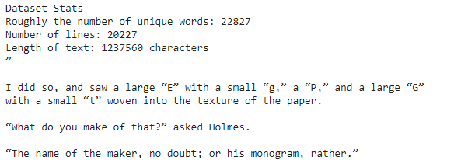
Sherlock Holmes Preprocessing the Data

Slide 8
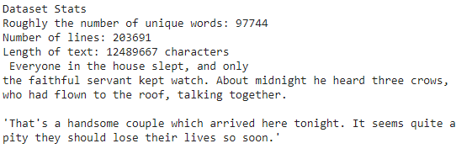
Fairy Tales Preprocessing the Data

Slide 9
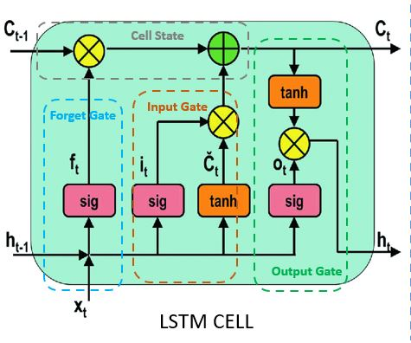
LSTM
Long Short Term Memory (LSTM) -- RNN network using Feedback connections
LSTM uses gate to control the memory process which allows it to ignore unnecessary information
The model stores in the memory the previous words and based on that word calculates the next

Slide 10
LSTM Process to Generate Text
Load the dataset and preprocess text.
Extract sequences of length n using the input vector then generate the next words
Build DataGenerator that returns batches of data.
Define the LSTM model and train it.
Predict the next word based on the sequence.

Slide 11
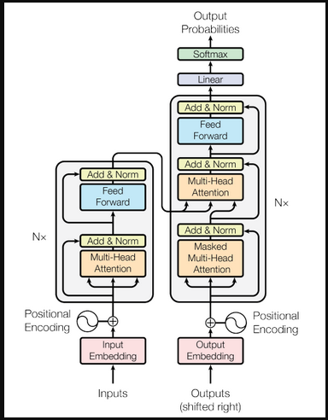
Transformer
The Transformer is the first transduction model relying entirely on self-attention to compute representations of its input and output without using sequence-aligned RNNs or convolution.
The Encoder block has 1 layer of a Multi-Head Attention followed by another layer of Feed Forward Neural Network. The decoder, on the other hand, has an extra Masked Multi-Head Attention.

Slide 12
Open AI GPT-2
OPen AI GPT-2 is a transformer based model
GPT-2 works like a traditional language model in that it takes word vectors and input and produces estimates for the probability of the next word as outputs. It is auto-regressive in nature,such that each token in the sentence has the context of the previous words
GPT-2 was trained on 40 Gb of high quality content
The model predicts the next word by using self attention
Hugging Face transformers library gives you what you need to train, fine-tune, and use transformer models

Slide 13
Transfer Learning Process to Generate Text
Load Tokenizer and Data Collator Load data and create a Dataset object Load the Model Load and setup the Trainer and Training Arguments Fine-tune the model Generate text with the Pipeline

Slide 14
Game of Thrones Text Output
A cold war had broken out. The sword had traveled with it and then had to be sent somewhere, somewhere, to strike down the foe. In two hours it had pierced the Iron Throne, and after six hours of war there was no man there for Robert III to beat down. "You are no longer a prisoner of the Dragon. Behold, I will hold all power, but my lords! You cannot call such a thing , you can say it. There are many who do the blood-and-spewing of our people ," thundered Robb, glancing over the ragged wound. Jaime Lannister, holding his arm as a blade, followed suit and Jaime stared deep into Theon's eye . The blade flew up to his head, glancing straight at him, "The traitor, the thief, the drunkard, I do not mean them to kill. They will not let him have a chance against my castle. I will hold them all. " "If the Dragon can not slay you, the Fire King has no time for you. You are my brothers," he declared wryly, in a voice that sounded like a jape as Robert turned, arms crossed, he saw through Cersei's long black hair, "but this man has no way of ending my day in his own place. I shall see to it that he kills or at least puts him back to our land. When I die my fate is sealed ." The old dragon eyed Robb . . . There has been a long delay. "Tell ye the truth, Robert," cried Davos, glancing at the sword the hanger was held in the holdfast. "You have an idea. You must see to it that I have held his head ." Ser Catelyn Stark had held one more , more —"I will save you my fellow-races," said his father as they looked up, and he looked down "there's no escaping it. It is the death of an old King, a young Stark, and you know well how dangerous its destiny is ." Jaime sat up, with Robert at his side as the two knights drove off the man.

Slide 15
Sherlock Holmes Text Output
But Mr. Morgan's face fell on Sherlock's. He spoke in the very tone he had never in his life expressed before: "No. No, no, not before I see my mother, the doctor, or a friend. Do not think at all of that, I assure you I will never do it myself again." In a strange way he replied like this; but his voice was firm but he did not want to sound so. When I sat down at the table, I would not stand down for a day in the hospital. I would not let his mind wander off to things like that.
Sherlock and his mother were now standing there listening for anything that Sherlock could come and tell them about to go on or not because they found it necessary to make such a stand before the doctor could be permitted a step if he looked up from his work. I did not give any consideration to the two friends, and they stood still watching the Doctor's face as Holmes got in.
In all this this was one of the most extraordinary episodes of my life and yet of mine. I never had such an ordinary childhood in my life without being in the home, with my husband and my little sister, and knowing little things, and in the presence of those who were my teachers and nurses. One morning when we had gone to St. James, and the Doctor and the two of us were out to dinner with our daughter and the grand-daughter of one of them, they found that her grandmother, sitting in my room, was standing by herself talking about her grandchildren and my grandparents only.

Slide 16
Fairy Tales Output
Once upon a time there lived an old man who came to seek
his fortune in beauty and wealth. He gave his old mistress the
wonderful portrait that now stood in his stead.
He therefore entrusted the request which she now gave him. He made a
charity of money to whoever could give it to him, and placed
her on his journeymen, and thus far he never made any mistake.
"Wherefore, my child?" said the old man.
"Well, it is all right, my child, that you have settled in home for
all eternity. I have, by the hand of my beloved, replaced the old
olde house with a new one. I want to give you my first diamond and
silver. For I am well satisfied with what I have obtained from you. You
must now purchase both of these things.

Slide 17
Future Challenges
More thought on how to begin stories and how to end them
Take in consideration the Genre the story occupies
In order to generate even longer stories like novellas or novels would need to consider how to create breakpoints like Chapters
How to define and decide the actual end of a story

